Slide 1

KGiSL INSTITUTE OF TECHNOLOGY
COIMBATORE
DEPARTMENT OF computer science & engineering
Project phase review # 02
AI DRIVEN SENSOR DRIVEN SYSTEM FOR IRRIGATION AND WATER WASTE MINIMIZATION
TEAM MEMBERS:
711720104061 Pavithra B 711720104064 Priyadharsini M
711720104071 Rositha A
711720104092 Sowmiya P
Under the guidance of :
Ms. Aruna T N , AP/CSE

Slide 2

agenda
Abstract
Existing System
Literature Review
Proposed System
Expected Outcome
Flow Chart
Module Split-up
Module-1
Module-2
References
Timeline
18-04-2024

Slide 3
abstract
AI Driven Sensor based system aims to revolutionize water management in agriculture by integrating artificial intelligence (AI) into piped and micro irrigation systems. By leveraging AI algorithms to predict crop water needs, automate valve controls, and optimize irrigation schedules, we seek to minimize water waste and maximize yield. The proposed system will employ sensors to gather real-time data on soil moisture, weather conditions, and crop health, enabling precise irrigation management tailored to the specific requirements of each field.
18-04-2024

Slide 4
EXISTING SYSTEM
Currently, water management in agriculture relies heavily on manual observation and traditional irrigation schedules
Drawbacks / Pitfalls of the Existing system
Farmers often face challenges in accurately assessing crop water needs, resulting in over- or under-irrigation, which can lead to water waste, decreased productivity, and environmental damage.
18-04-2024

Slide 5
Literature Survey
TITLE | PUBLICATION YEAR | AUTHOR / PUBLISHER | METHODOLOGIES
“Model Predictive Control Structures for Periodic ON–OFF Irrigation” | 2023 | Gabriela B. Cáceres; Antonio Ferramosca; Pablo Millán Gata; Mario Pereira Martín | Description: The main objective of this study is to develop and evaluate periodic model predictive control structures that explicitly account for on-off irrigation, a characteristic of drip irrigation systems . Drawback: watering will be turned on and off manually.
“Optimal Irrigation Allocation for Large-Scale Arable Farming" | 2022 | A. T. J. R. Cobbenhagen; L. P. A. Schoonen; M. J. G. van de Molengraft; W. P. M. H. Heemels IEEE Transactions on Control Systems Technology | Description: Comprises of optimization frameworkthat computes the allocation of irrigation machinery and water to arable fields by maximization of a profit. Drawback: Suitable only for small scale arable farming.
"AgriSens: IoT-Based Dynamic Irrigation Scheduling System for Water Management of Irrigated Crops” | 2021 | Sanku Kumar Roy;Sudip Misra; Narendra Singh Raghuwanshi; Sajal K. Das IEEE Internet of Things Journal | Description: Dynamic irrigation scheduling system for efficient water management of irrigated crop fields and provides real time, automatic, dynamic as well as remote manual irrigation treatment for different growth phases of a crop’s life cycle. Drawback: Low efficient monitoring.

Slide 6
Literature Survey
TITLE | PUBLICATION YEAR | AUTHOR / PUBLISHER | METHODOLOGIES
"Artificial Neural Networks and Computer Vision's-Based Phytoindication Systems for Variable Rate Irrigation Improving" | 2021 | Galina Kamyshova , Aleksey Osipov, Sergey Gataullini , Sergey Korchagin, Stefan Ignar, Timur Gataullini, Nadezhda Terekhova, and Stanislav Suvorov | Description: Determines the rate of watering of plants in the current sector of the location of the sprinkler with the help of 8 IP cameras. Drawback: Lack of efficiency in monitoring.
“Water Management in Agriculture: A Survey on Current Challenges and Technological Solutions” | 2020 | Abdelmadjid Saad; Abou El Hassan Benyamina; Abdoulaye Gamatié | Description: Aiming at optimizing water usage, and improving the quality and quantity of agricultural crops, while minimizing the need for direct human intervention. Drawback: Low efficient water management and monitoring.
"An Optimized Water Distribution Model of Irrigation District Based on the Genetic Backtracking Search Algorithm" | 2019 | Zhipeng Sun; Jian Chen; Yu Han; Rui Huang; Qi Zhang; Shanshan Guo | Description: Improving irrigation efciency in order to balance water supply and demand has become an urgent need for social development in the northwest of China. Drawbacks: Trained based on a specific location.

Slide 7
PROPOSED SYSTEM
The AI Driven Sensor based System will integrate AI-driven technology with sensor networks to create a smart irrigation system capable of optimizing water management in piped and micro irrigation setups. AI algorithms will analyze data from various sources, including soil moisture sensors and adjust irrigation schedules and flow rates in real time to ensure optimal moisture levels in the soil while minimizing water waste.
Advantages over existing method
Improved Water Efficiency
Real-time Monitoring and Control
Decision Making
18-04-2024

Slide 8
EXPECTED OUTCOME
Improvements in water efficiency.
Better crop yields.
Improved soil moisture management.
18-04-2024

Slide 9
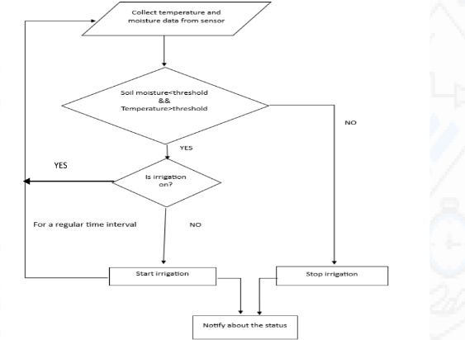
FLOW CHART
18-04-2024

Slide 10
MODULEs SPLIT-UP
Module 1 – Histogram Equalization
Module 2 – Hardware Assembling
Module 3 – Hardware Implementation
Module 4 – User Application
18-04-2024

Slide 11
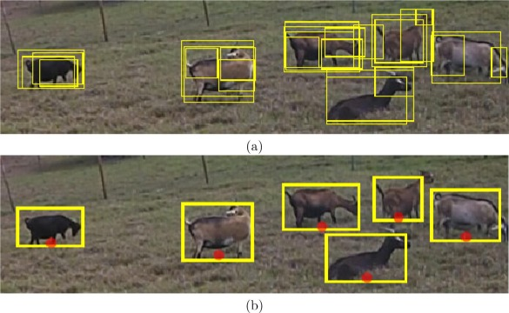
MODULE 1- Histogram Equalization
With the goal of enhancing security and providing proactive wildlife monitoring, this research combines OpenCV with embedded technologies to detect animals in real time. It provides a productive way to identify and notify people about the presence of animals and humans by utilising computer vision algorithms and hardware elements like cameras and LCD screens. This approach has potential uses in security monitoring and wildlife conservation.
18-04-2024

Slide 12
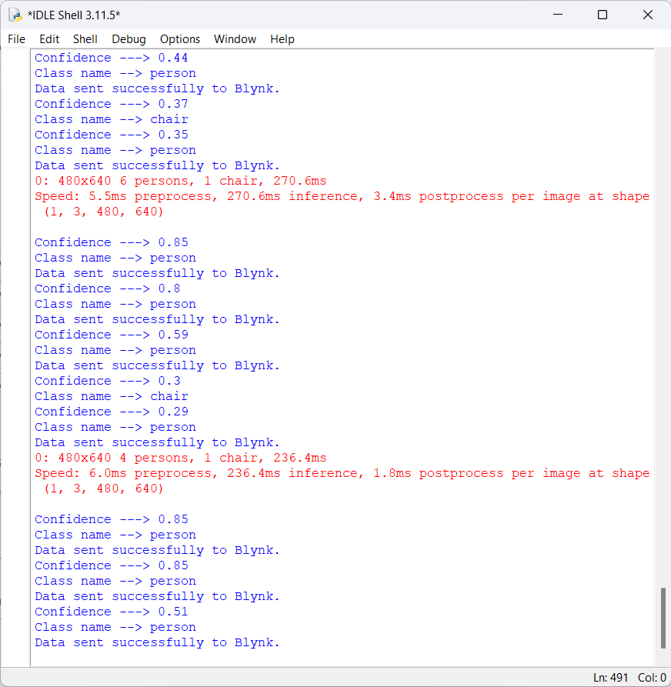
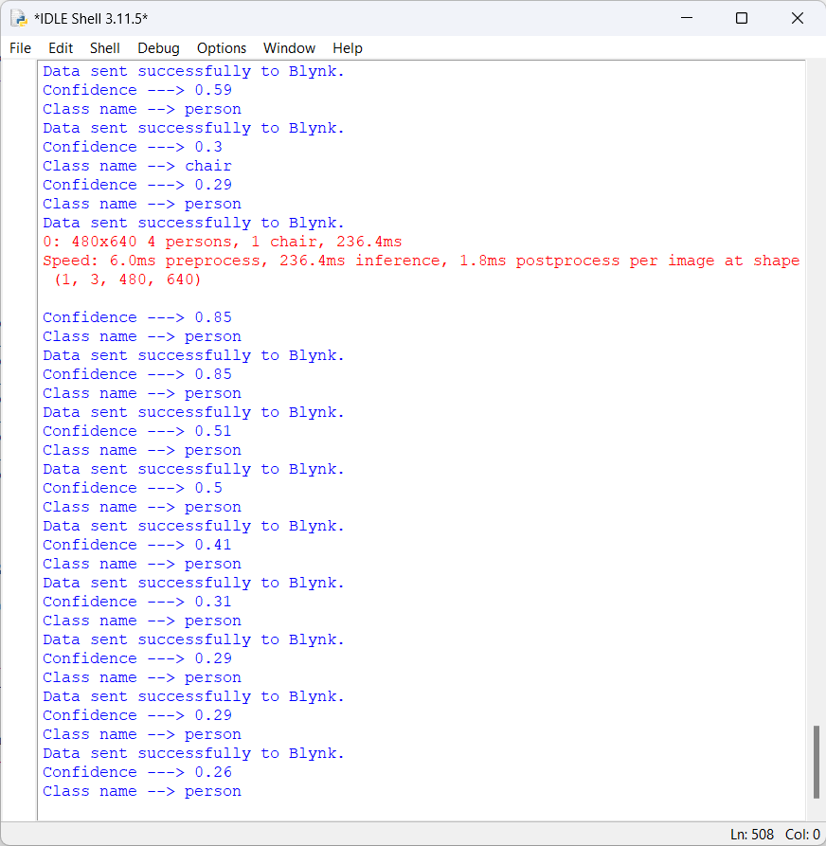
EXPECTED OUTCOME
18-04-2024

Slide 13
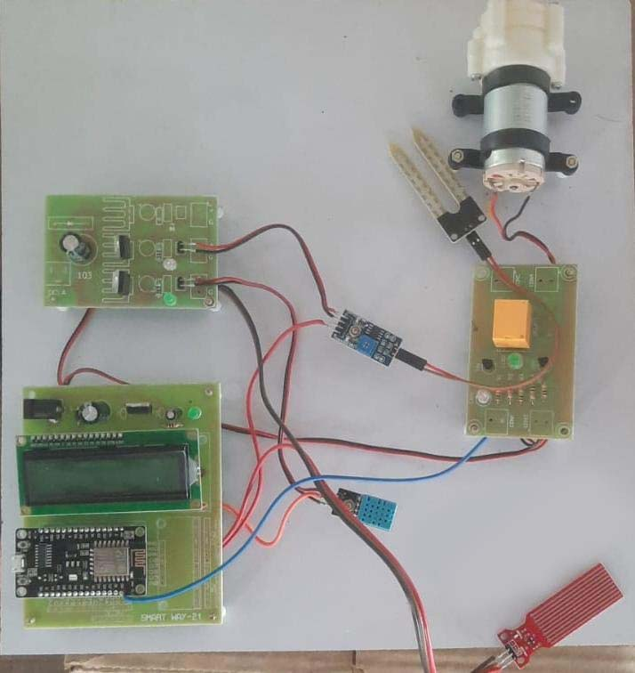
MODULE 2- HARDWARE ASSEMBLING
18-04-2024

Slide 14
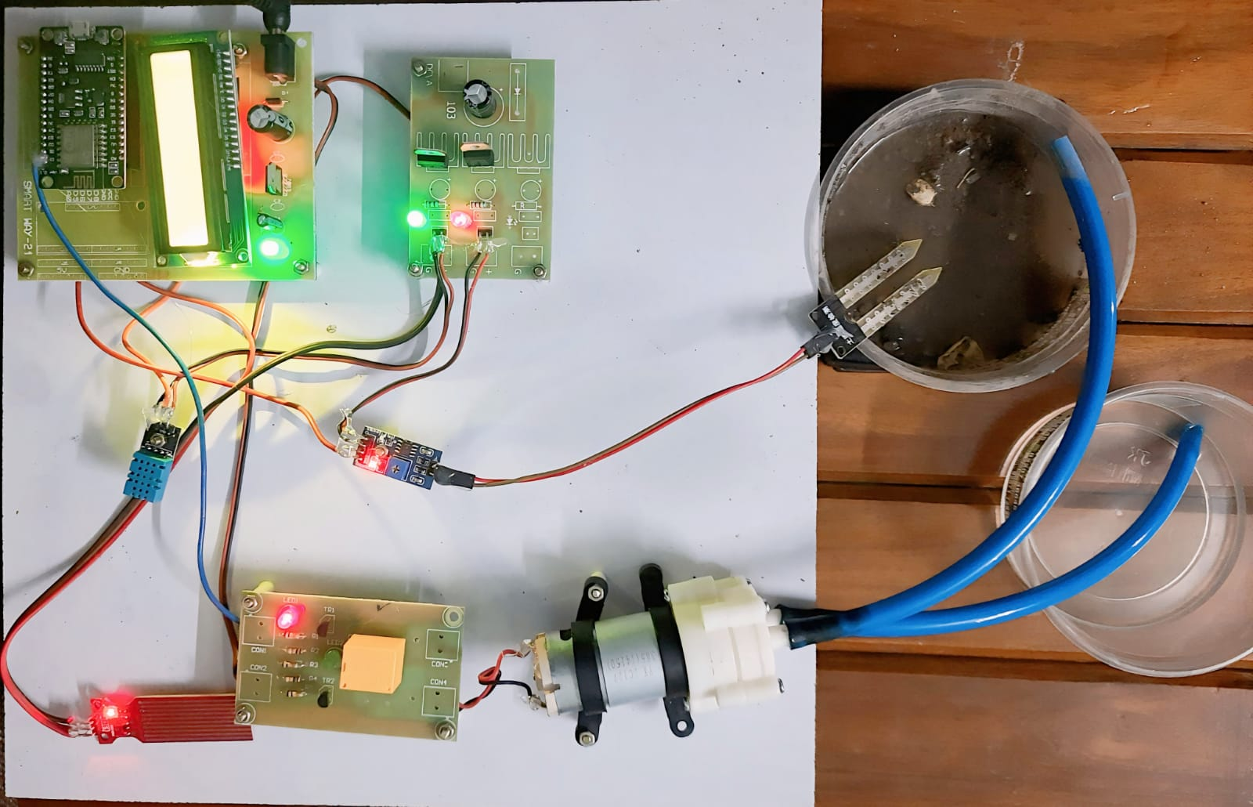
MODULE 3
hardware implementation
18-04-2024

Slide 15
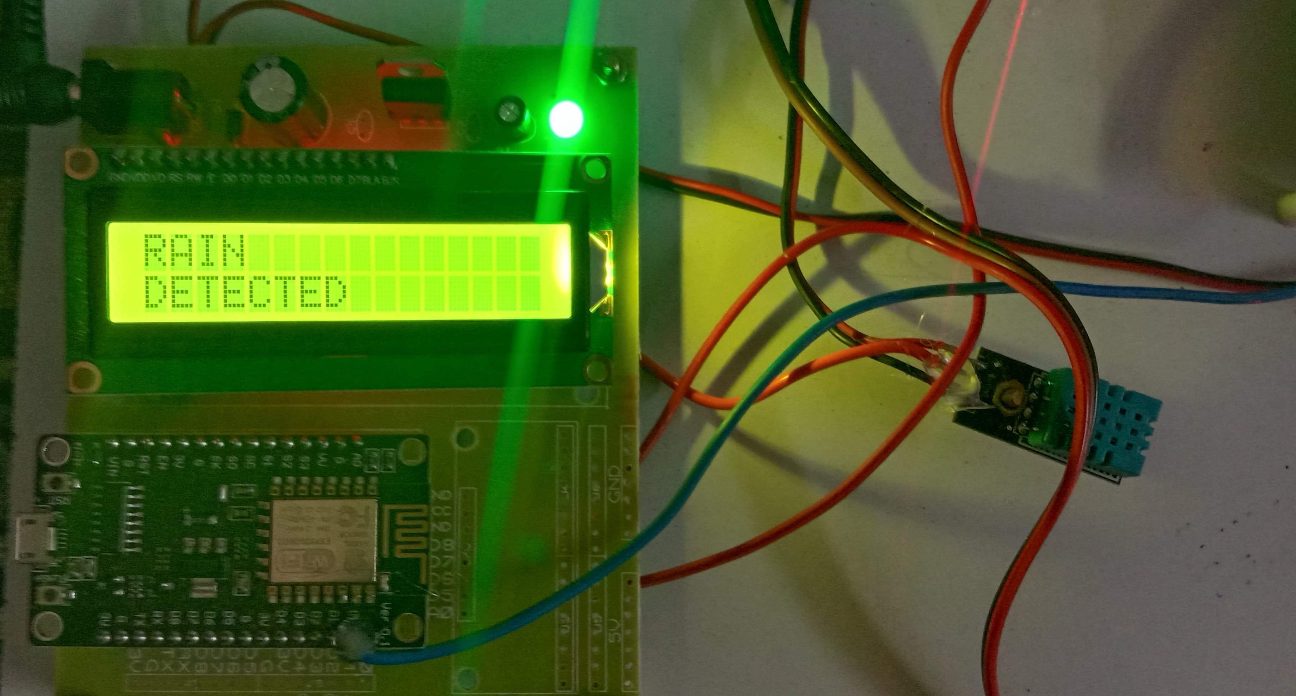
MODULE 3
hardware implementation
18-04-2024

Slide 16
MODULE 4
user application
18-04-2024

Slide 17
REFERENCE
[1] Ali, M., Bhatti, A., & Iqbal, R. (2019). Doorstep collection of household plastic waste: A case study of a UK waste management company. Waste Management & Research, 37(8), 853-860.
[2] Parker, L., Tolfrey, K., & Halog, A. (2021). Plastic waste management in low- and middle-income countries: a systematic review of barriers and enablers. Journal of Environmental Management, 298, 113540.
[3] Hopewell, C., Kosior, E., & Bull, S. (2019). Sustainable plastic waste management towards a circular economy: the role of technology, policy, and society. Science of the Total Environment, 658, 1143-1151.
[4] Nguyen, L., Le, Q. T., & Vu, T. T. (2020). Door-to-door collection of plastic waste in an urban area: A pilot study in Hanoi, Vietnam. Resources, Conservation and Recycling, 161, 104966.
[5] Escobar, N., Zuniga, E., & Mora, E. (2021). Evaluation of a Door-to-Door Plastic Waste Collection Pilot Program in a Rural Community in Costa Rica. Sustainability, 13(4), 2132.

Slide 18
REFERENCE
[6] Chavannes, C., Vellinga, T. V., & Breure, A. M. (2020). Do doorstep waste collection schemes increase recycling rates and reduce residual household waste? A case study of Amsterdam. Journal of Cleaner Production, 249, 119345.
[7] Hossain, M. S., & Rahman, M. M. (2019). Improving the recycling rate of plastic waste through doorstep collection in Bangladesh. Resources, Conservation and Recycling, 148, 144-153.
[8] Wang, L., Su, Y., Zhao, W., & Du, J. (2019). Door-to-door collection of waste plastics in China: opportunities and challenges. Waste Management & Research, 37(8), 861-865.
[9] Kumar, S., & Dhar, H. (2019). Evaluating the effectiveness of door-to-door collection of recyclables in reducing municipal solid waste in Indian cities. Journal of Material Cycles and Waste Management, 21(4), 869-877.
[10] Ezeah, C., & Roberts, C. L. (2020). Urban household waste management practices and sustainability in Lagos, Nigeria: A focus on source separation and door-to-door collection. Journal of Cleaner Production, 244, 118886.
18-04-2024

Slide 19
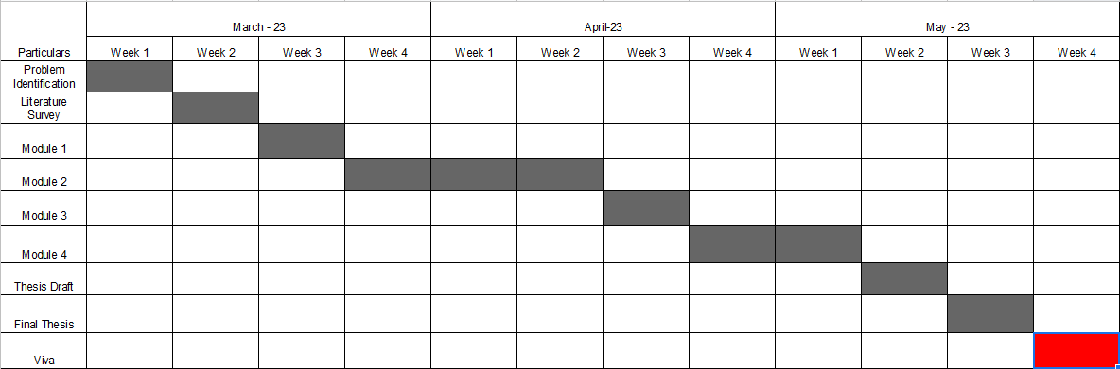
TIMELINE
March-24
April-24
May -24

Slide 20
THANK YOU

